Slide 1




Towards Optimal Concolic Testing
Xinyu Wang¹, Jun Sun², Zhenbang Chen³, Peixin Zhang¹, Jingyi Wang² and Yun Lin⁴
¹Zhejiang University, China
²Singapore U. of Tech. and Design, Singapore
³National U. of Defense Technology, China
⁴National University of Singapore, Singapore
Notes:
报告的题目是towards Optimal Conconlic Testing， 这项工作由浙江大学、新加坡SUTD大学，国防科技大学和NUS共同完成。

Slide 2
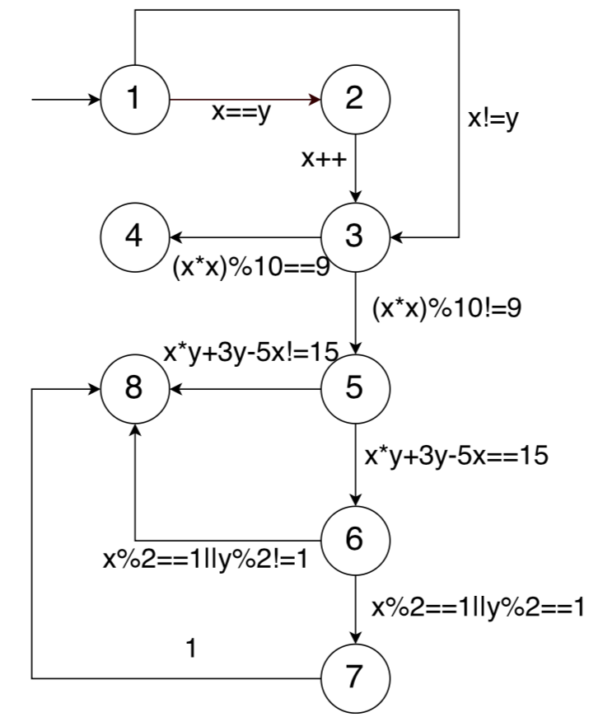
Example
void myfunc(int x, int y){
1. if(x==y){
2. x++;
}
3. if ((x*x)%10==9){
4. return;
}
5. if (x*y+3*y-5*x==15){
6. if (x%2==1 ||y%2==1){
7. x = x-y;
}
}
8. return;
}
How to generate test cases to cover all statements?

Slide 3
Testing Strategy
Option 1: Random testing
“Cheap” at covering high-probability paths
“Expensive” at covering low-probability paths

Slide 4
Testing Strategy
Option 2: Symbolic Execution
The cost of symbolic execution is relatively expensive, especially for complicated paths
Symbolic execution can ”make sure“ to get the given state

Slide 5
Concolic Testing
Scheduling between random testing and symbolic execution
Scheduling of paths for symbolic execution
Example：
Solve path <1, 2> and path <1,3,5,6>
Apply random testing to cover the rest
How should we combine symbolic execution and random testing?

Slide 6
Existing Heuristics
These are all heuristics. Can we define what is the optimal strategy and propose better algorithms?
Depth-First Search (PLDI’05)
Coverage-Optimized Search (OSDI’08)
Generational Searching (CACM’12)
Steering Symbolic Execution to Less Traveled Paths (OOPSLA’13)
Context-Guided Search (FSE’14)
Automatically Generating Search Heuristics for Concolic Testing (ICSE’18)
...

Slide 7
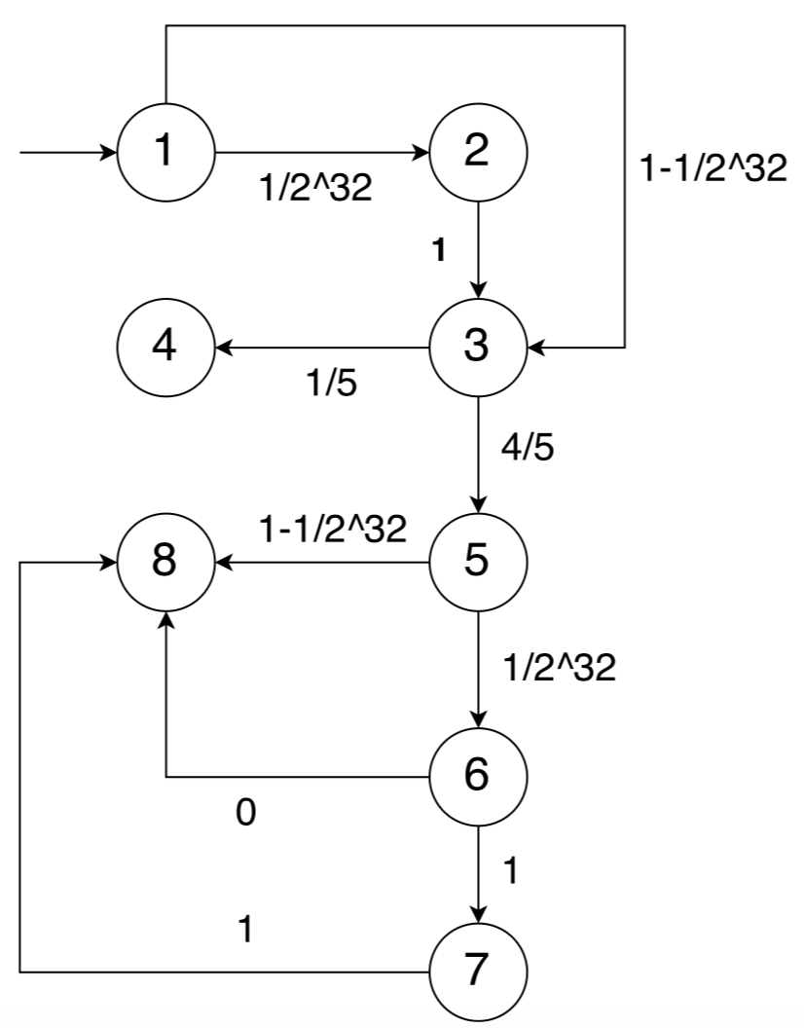
Understanding Random Testing
The effectiveness of random testing on covering a node depends on the probability of reaching the node
Example: The probability of covering node 4 is 1/5 which means on average 5 random test cases are needed to cover it

Slide 8
Cost of Symbolic Execution
To measure the effectiveness of symbolic execution, we need to know the relative cost of symbolic execution
Example：
Generate a random test: cost 1 time unit
Symbolically execute path <1,2>: cost 4 time units
Symbolically execute path <1,3,5,6>: cost 50 time units

Slide 9
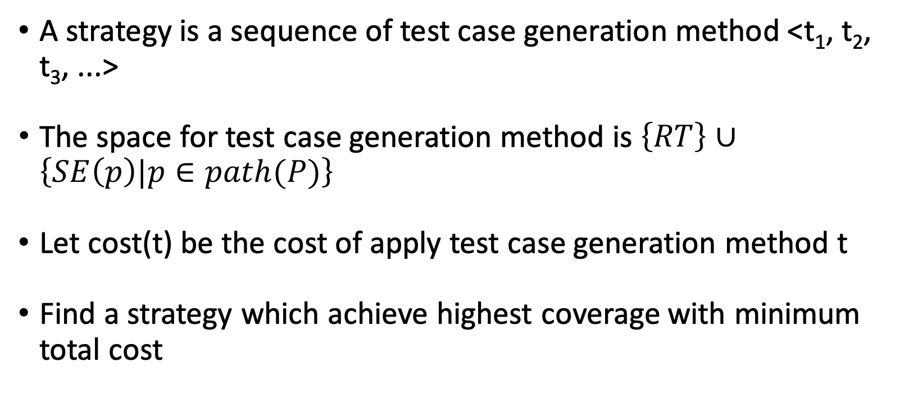
Let’s Get Formal: Problem
A strategy is a sequence of test case generation method <t₁, t₂, t₃, ...>
The space for test case generation method is $\left\{RT\right\}∪\left\{SE\left(p\right)|p∈path(P)\right\}$
Let cost(t) be the cost of apply test case generation method t
Find a strategy which achieve highest coverage with minimum total cost

Slide 10
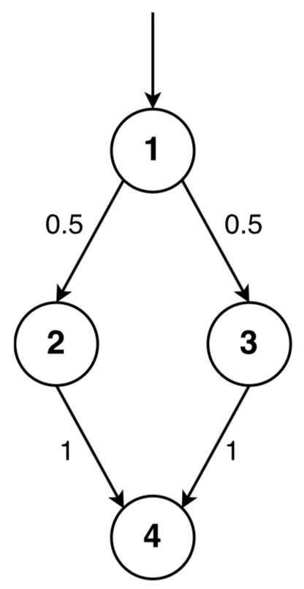
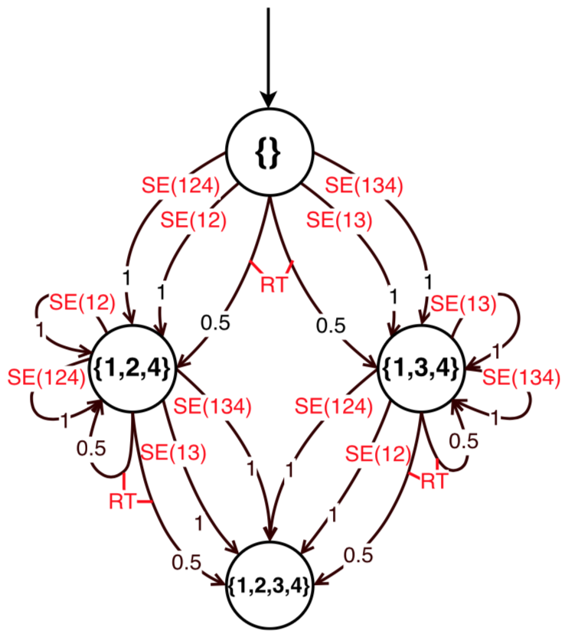
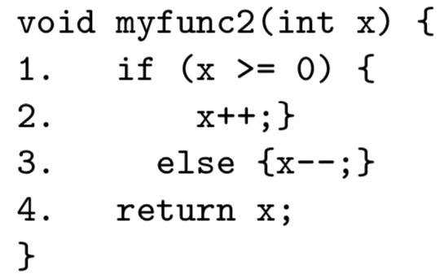
Let’s Get Formal: Solution
The problem of finding an optimal strategy can be reduced to a model checking problem of Markov Decision Processes with Costs
If we know the program probability and the cost of symbolic execution (of each program path), the problem can be perfectly solved by model checking

Slide 11
How Good Are Existing Heuristics?
Experiment Setting
Randomly generated DTMC models representing abstraction of programs
Randomly generated costs representing the cost of symbolic execution for each branch
Each condition has 50 models and each method runs 1000 times
 | 5 states | 10 states | 15 states | 20 states
Optimal | 1 | 1 | 1 | 1
RT | 138.9 | 11.3 | 44.2 | 114.7
RCN | 1.7 | 14.4 | 15.1 | 12.7
RSS | 12.8 | 50.7 | 64.0 | 68.1
RPS | 12.8 | 50.6 | 63.9 | 68.5
DFS | 7.1 | 27.4 | 21.8 | 18.6
DART | 1.8 | 13.0 | 12.8 | 13.0
GS | 1.9 | 13.5 | 13.9 | 13.3
CGS | 1.8 | 12.6 | 13.6 | 13.8
SGS | 11.2 | 32.4 | 29.4 | 25.5
Existing approaches have a lot of room to improve!

Slide 12


Let’s Get Practical
Problem 1: How do we know the program probability?
Through Laplace Estimation.
Problem 2: How do we know the cost of symbolic execution?
Function fitting (empirically).
Problem 3: Model checking is too expensive!
Be greedy.

Slide 13
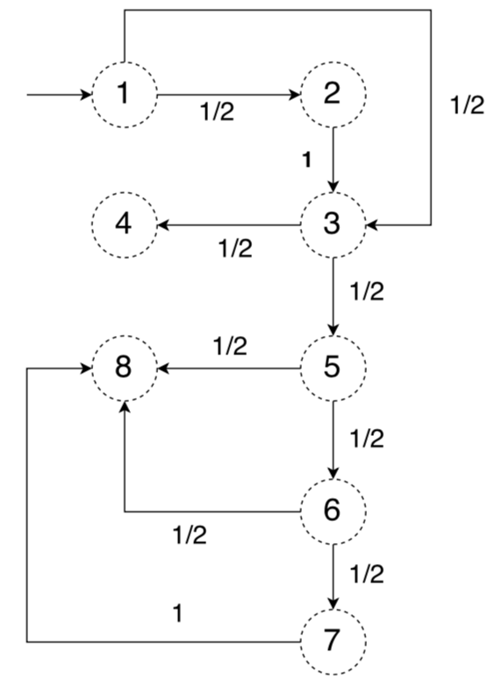
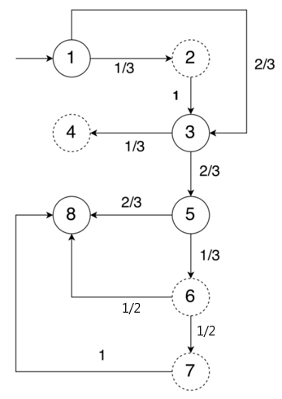

Estimating Probability
Use Laplace Estimation to estimating the probability of program
If it is impossible for s to reach t in P, set Pr(s, t) = 0
Otherwise, set Pr(s,t) = $\frac{\#\left(s, t\right) + 1}{\#s + n}$
π =⟨1, 3, 5, 8⟩

Slide 14
Estimating Cost
Use Function Fitting to estimating cost
Assuming the cost is the weighted sum of the primitive operations
According collected cost to estimate the weight
Given a constraint, its cost is estimated as the weighted sum of all primitive operations
e.g. Constraint c is a * b > 0, so SC(c) = WC(*) + WC(>)

Slide 15
Empirical Cost
Solving a linear (in)equality or their conjunctions has time cost 4
Solving a nonlinear (in)equality has cost of 10
Solving a boolean combination of nonlinear (in)equalities has cost of 50

Slide 16
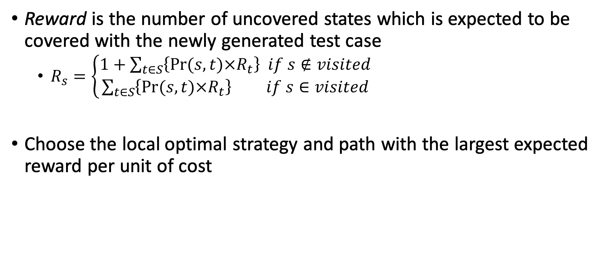
Greedy Algorithm
Reward is the number of uncovered states which is expected to be covered with the newly generated test case
$R_{s}=\left\{\begin{aligned}1+\sum_{t∈S}{\left\{Pr⁡(s,t)×R_{t}\right\} if s∉visited} \\ \sum_{t∈S}{\left\{Pr⁡(s,t)×R_{t}\right\} if s∈visited}\end{aligned}\right.$
Choose the local optimal strategy and path with the largest expected reward per unit of cost

Slide 17

Greedy Algorithm
Apply Laplace estimation to get the initial DTMC on the right
Since no test cases have been executed, start with random testing
Assume the random test case covers 1, 3, 5 and 8
Apply Laplace estimation to update the DTMC

Slide 18
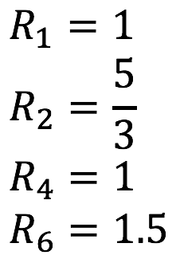
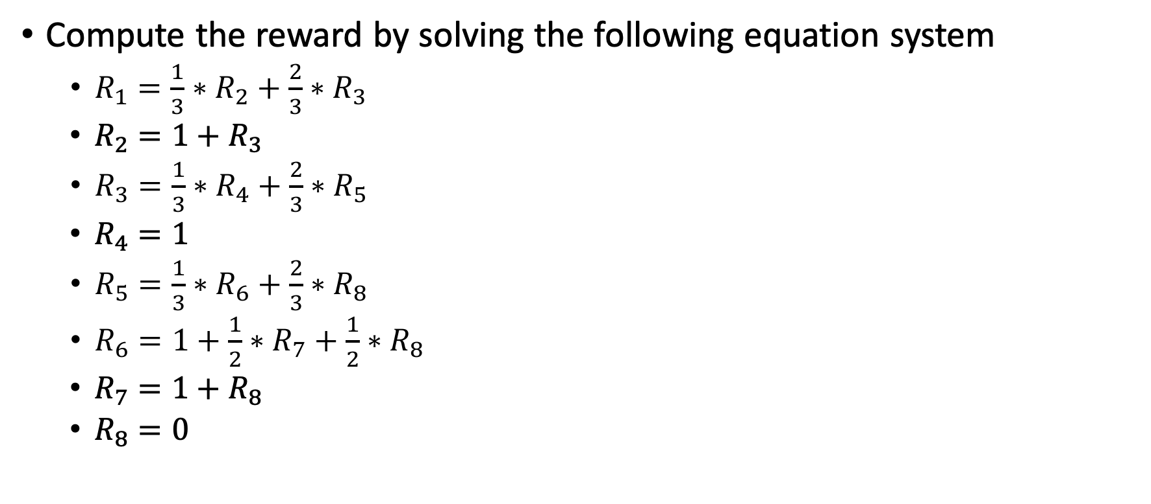
Greedy Algorithm
Compute the reward by solving the following equation system
$R_{1}=\frac{1}{3}∗R_{2}+\frac{2}{3}∗R_{3}$
$R_{2}=1+R_{3}$
$R_{3}=\frac{1}{3}∗R_{4}+\frac{2}{3}∗R_{5}$
$R_{4}=1$
$R_{5}=\frac{1}{3}∗R_{6}+\frac{2}{3}∗R_{8}$
$R_{6}=1+\frac{1}{2}∗R_{7}+\frac{1}{2}∗R_{8}$
$R_{7}=1+R_{8}$
$R_{8}=0$

Slide 19
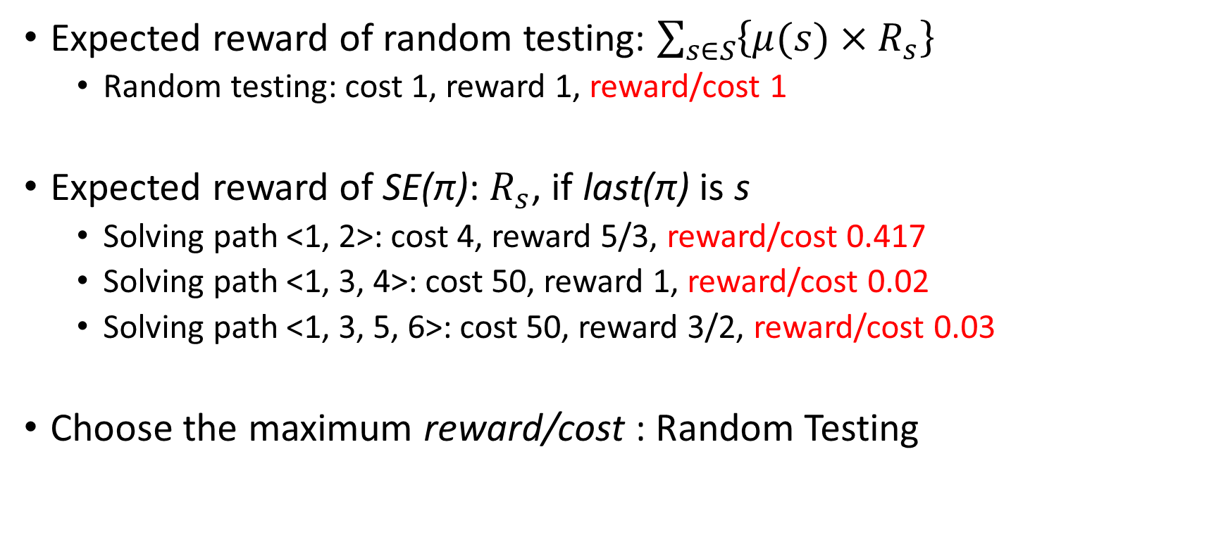
Greedy Algorithm
Expected reward of random testing: $\sum_{s∈S}{\left\{μ(s)×R_{s}\right\}}$
Random testing: cost 1, reward 1, reward/cost 1
Expected reward of SE(π): $R_{s}$, if last(π) is s
Solving path <1, 2>: cost 4, reward 5/3, reward/cost 0.417
Solving path <1, 3, 4>: cost 50, reward 1, reward/cost 0.02
Solving path <1, 3, 5, 6>: cost 50, reward 3/2, reward/cost 0.03
Choose the maximum reward/cost : Random Testing

Slide 20
Greedy Algorithm
Assuming the first 10 random testing all cover <1,3,5,8>
According the given formula:
RT: cost 1, reward 0.335, reward/cost 0.229
SE<1,2>: cost 4, reward 1.138, reward/cost 0.284
SE<1,3,4>: cost 50, reward 1 , reward/cost 0.02
SE<1,3,5,6>: cost 50, reward 1.5 , reward/cost 0.03
Symbolic Execution on <1,2>
Repeat until we cover all reachable nodes or timeout.

Slide 21
Evaluation
Experiment 1
Randomly generated DTMC models representing abstraction of programs
Randomly generated costs representing the cost of symbolic execution for each branch
Each condition has 50 models and each method runs 1000 times
 | 5 states | 10 states | 15 states | 20 states
Optimal | 1 | 1 | 1 | 1
RT | 138.9 | 11.3 | 44.2 | 114.7
RCN | 1.7 | 14.4 | 15.1 | 12.7
RSS | 12.8 | 50.7 | 64.0 | 68.1
RPS | 12.8 | 50.6 | 63.9 | 68.5
DFS | 7.1 | 27.4 | 21.8 | 18.6
DART | 1.8 | 13.0 | 12.8 | 13.0
GS | 1.9 | 13.5 | 13.9 | 13.3
CGS | 1.8 | 12.6 | 13.6 | 13.8
SGS | 11.2 | 32.4 | 29.4 | 25.5
G | 2.1 | 4.8 | 3.1 | 4.8

Slide 22
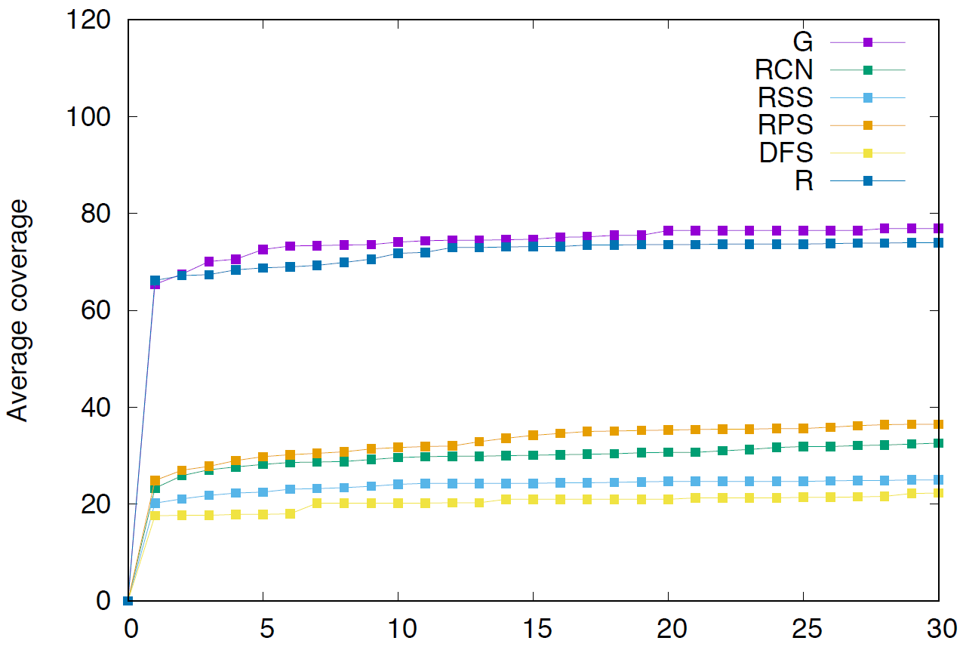
Evaluation
Experiment 2
Extend KLEE with greedy strategy
Use a set of program in GNU Scientific Library as test subjects
Measure the coverage achieved by different strategies over time

Slide 23
Conclusion
Firstly define and solve the problem of optimal concolic testing
Existing heuristics have much room to improve
We propose a greedy algorithm which approximates the optimal one

Slide 24
Thank you !
Questions? Comments? Advice?

